Slide 1
Notes:
There are aspects of a language that are impossible to understand, unless you interact. Directly. And learn in person.
How do we prepare a platform for the market? How do we monetise, in a setting like a language community, historically difficult to deal with?

Slide 2

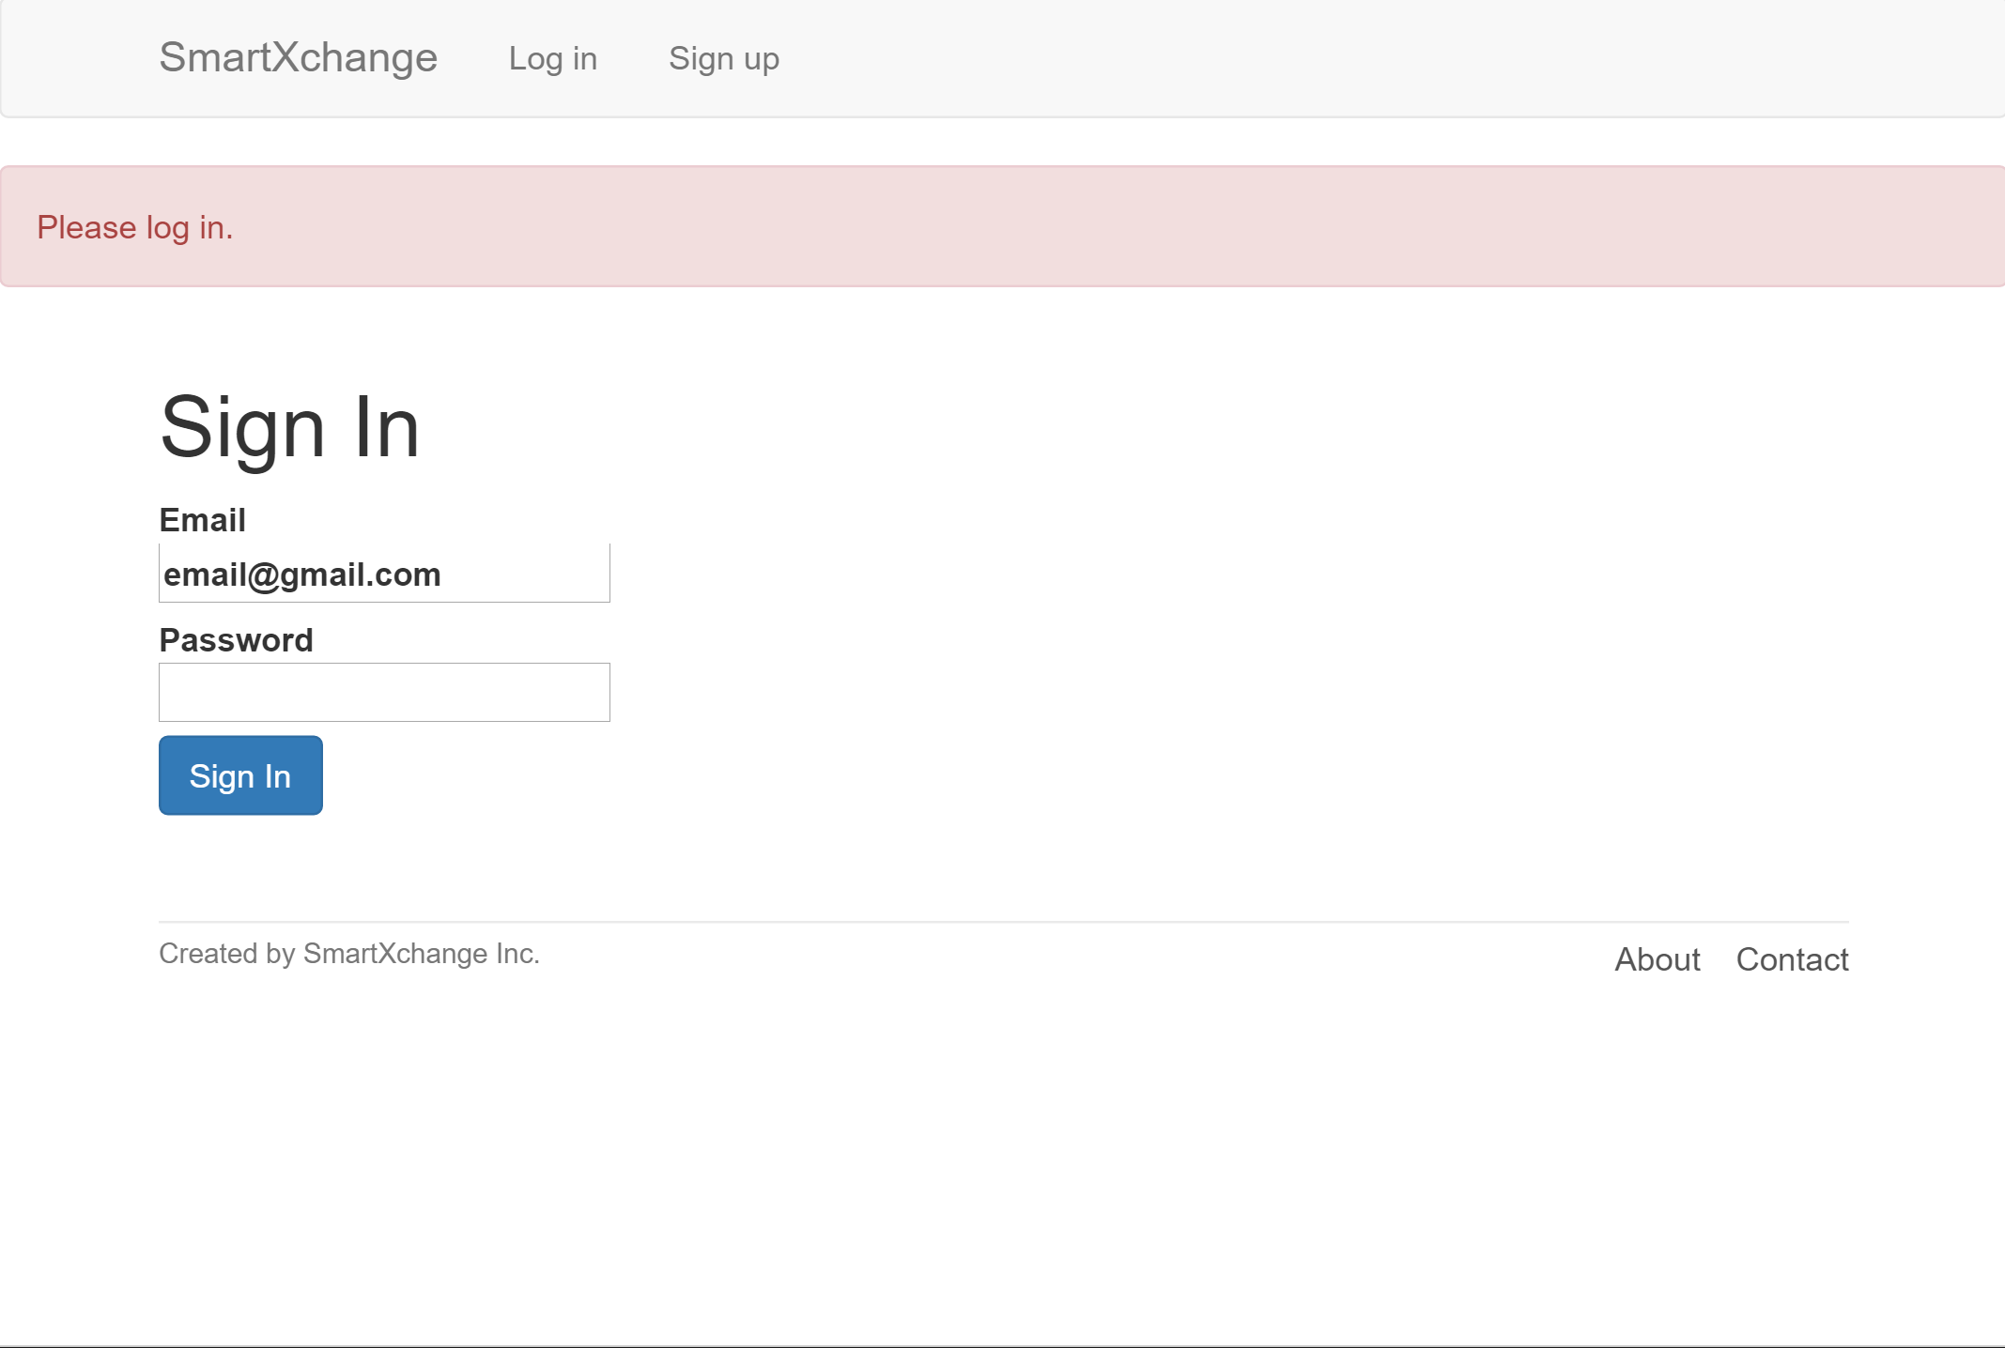
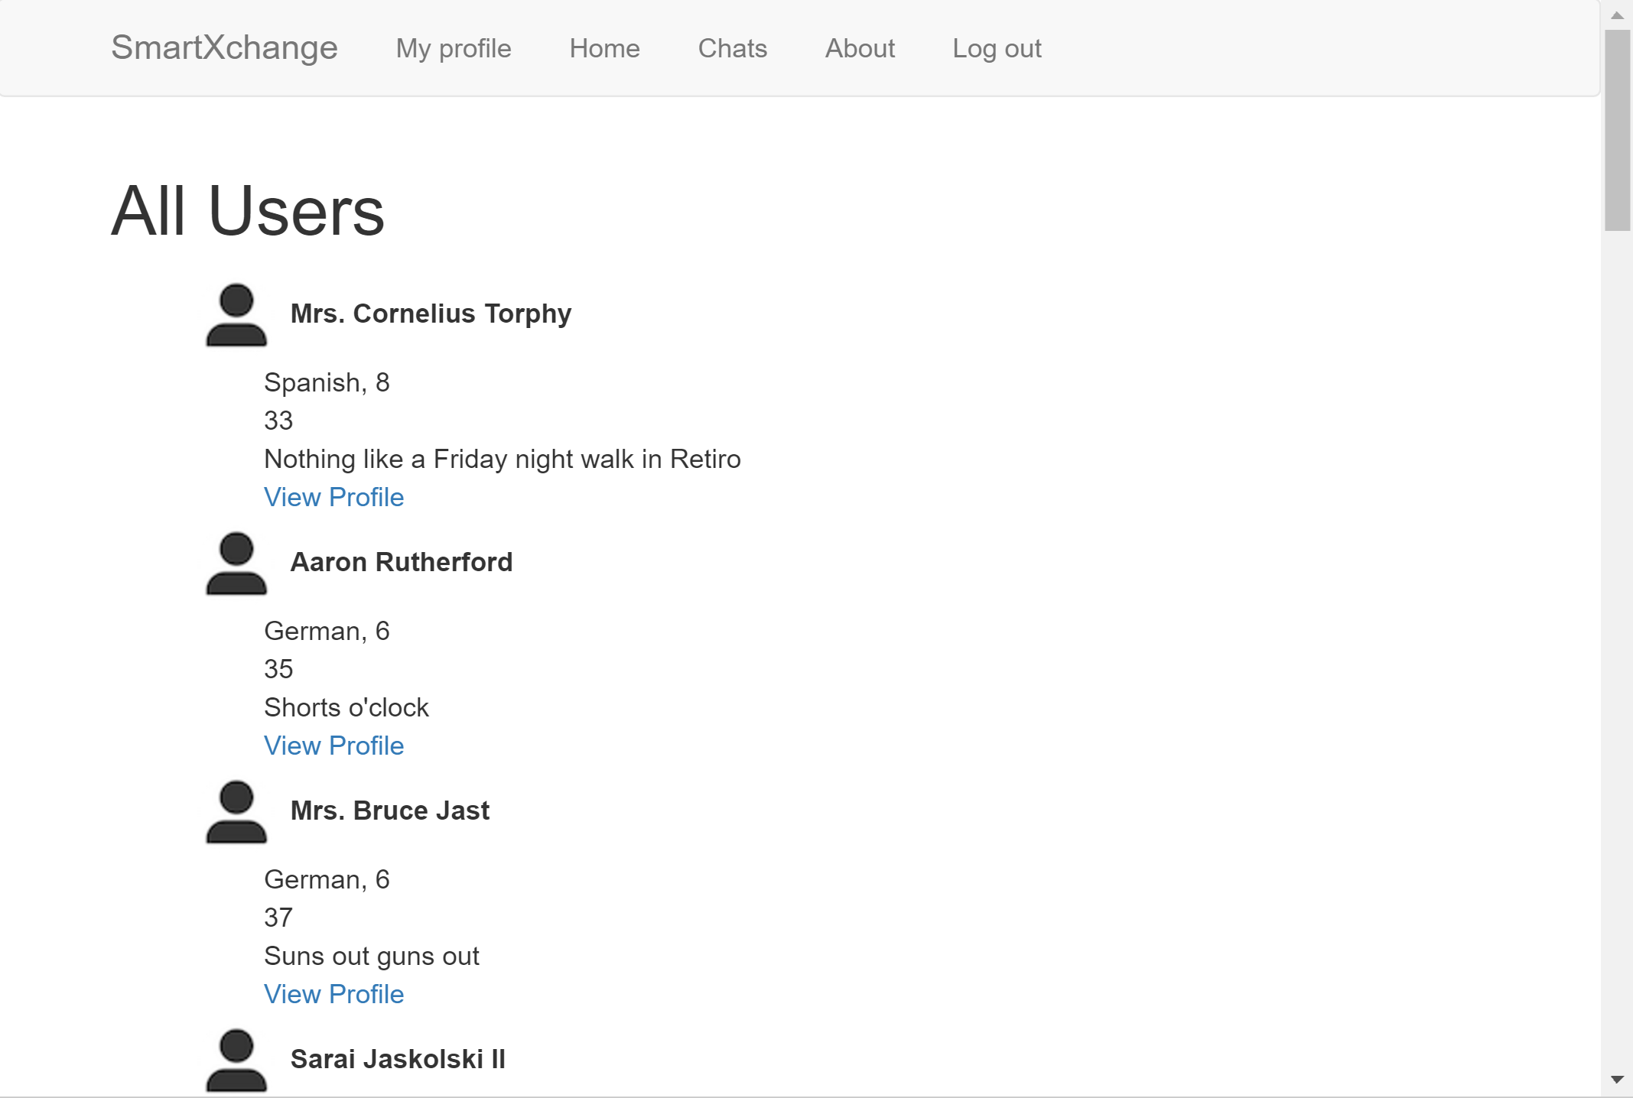
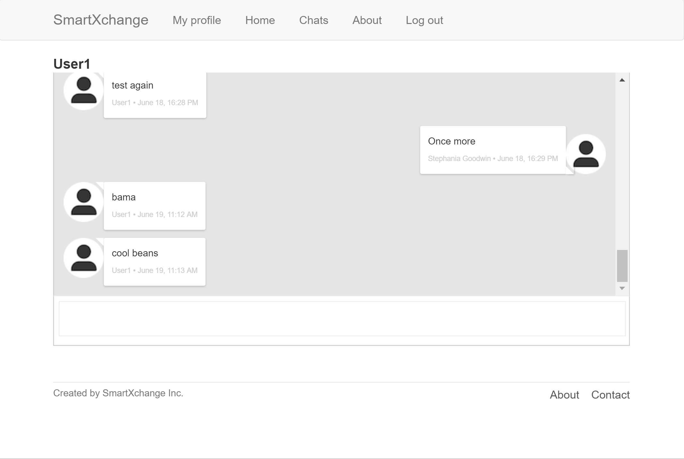
THE FIRST TECH DEMO
Notes:
How do you prepare this to something ready for the market? In today’s hyperactively entrepreneurial world, this kind of skill is more and more critical.

Slide 3

Our plans had to change
during the project.

Slide 4

95% of the interviewed learn a 2nd language
THE ENVIRONMENT

Slide 5
85% want to practice a language right now
THE ENVIRONMENT

Slide 6
79% are confident in meeting new people
THE ENVIRONMENT

Slide 7
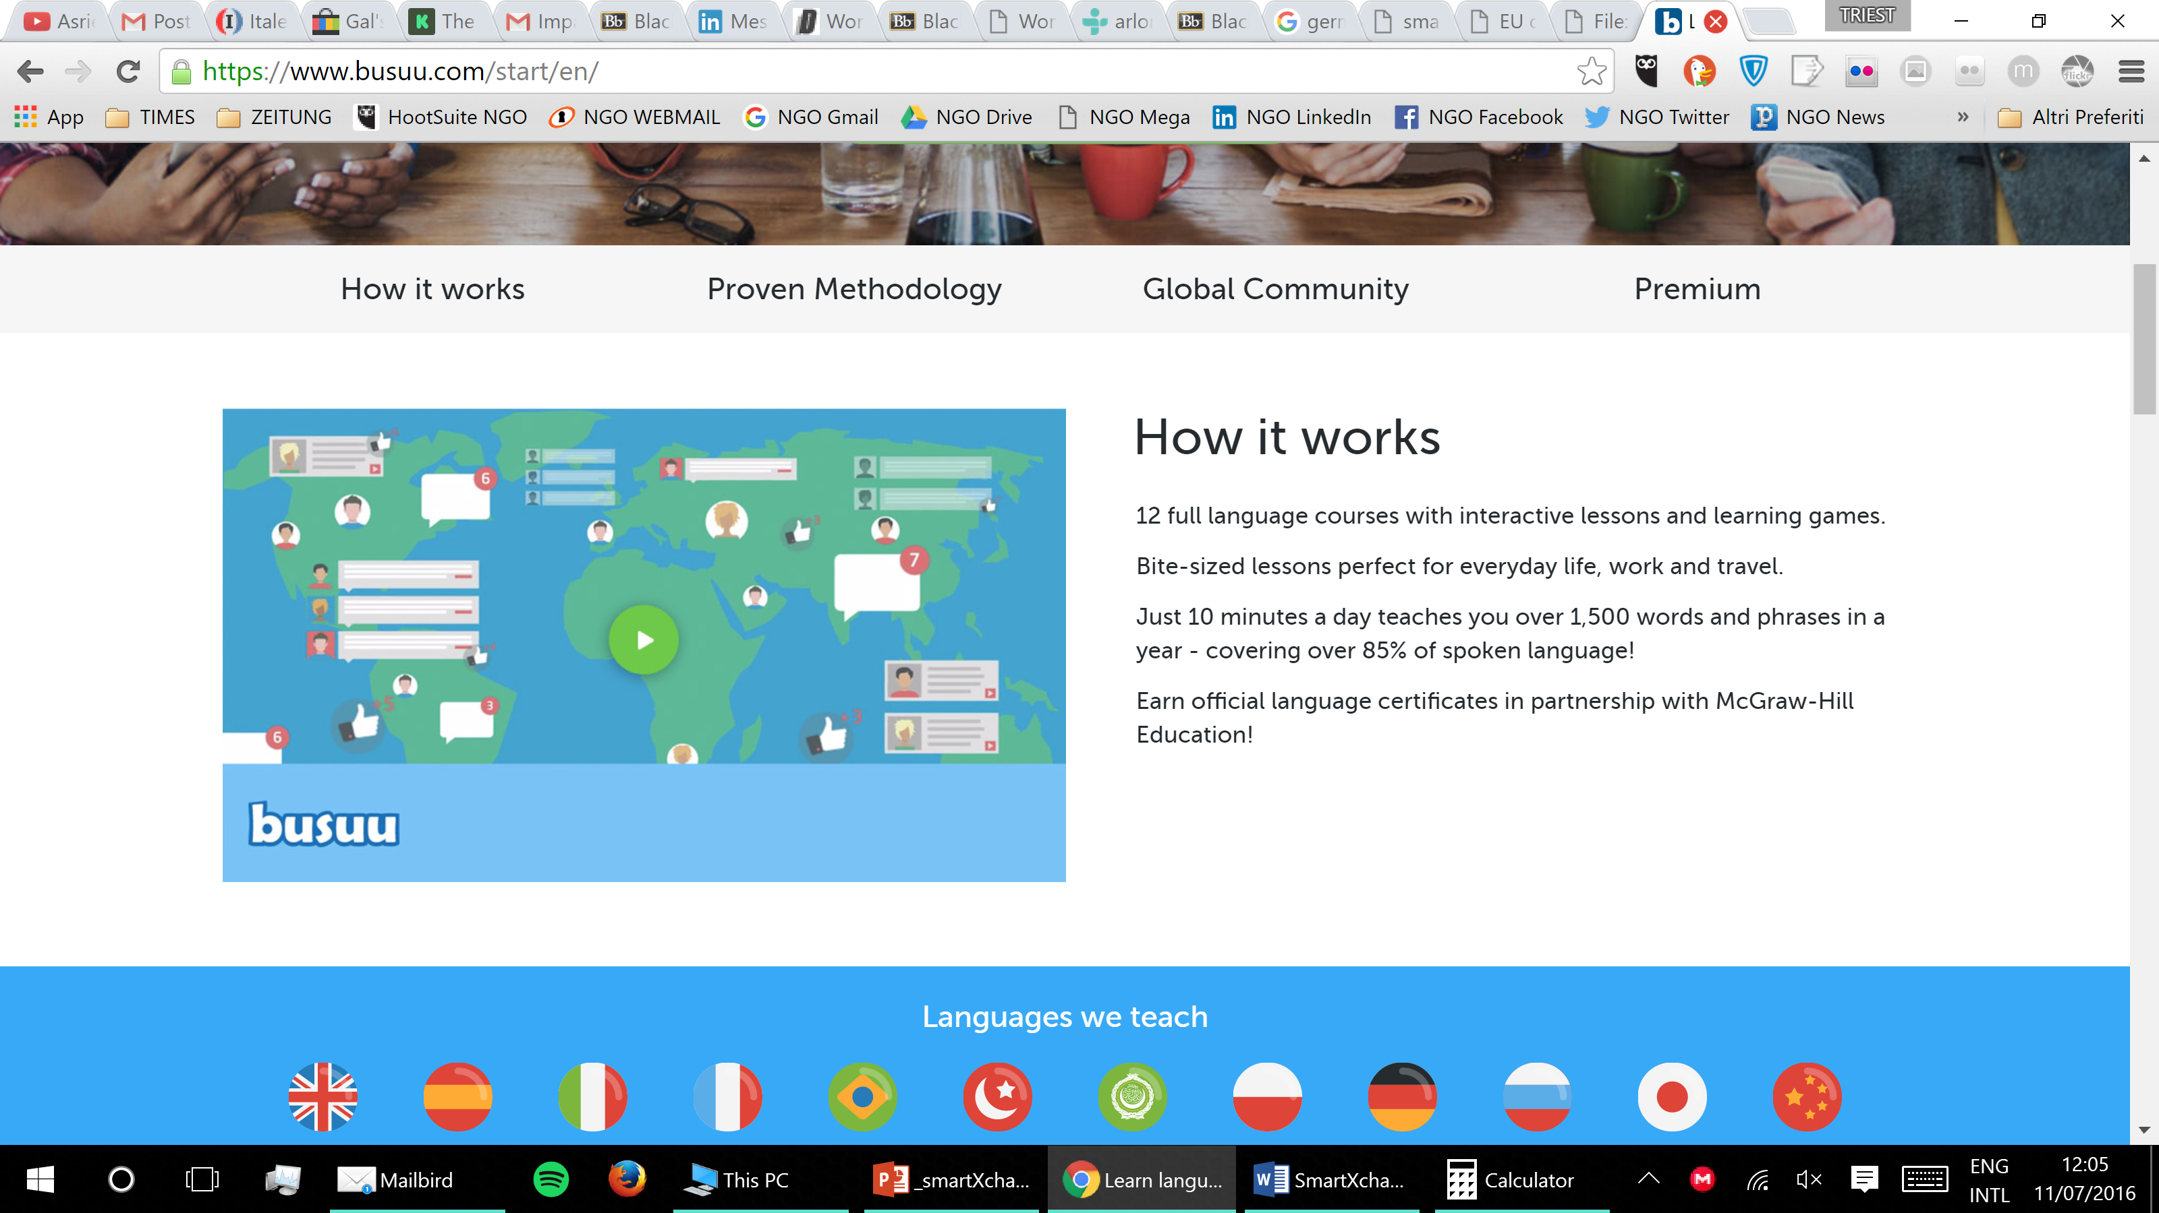
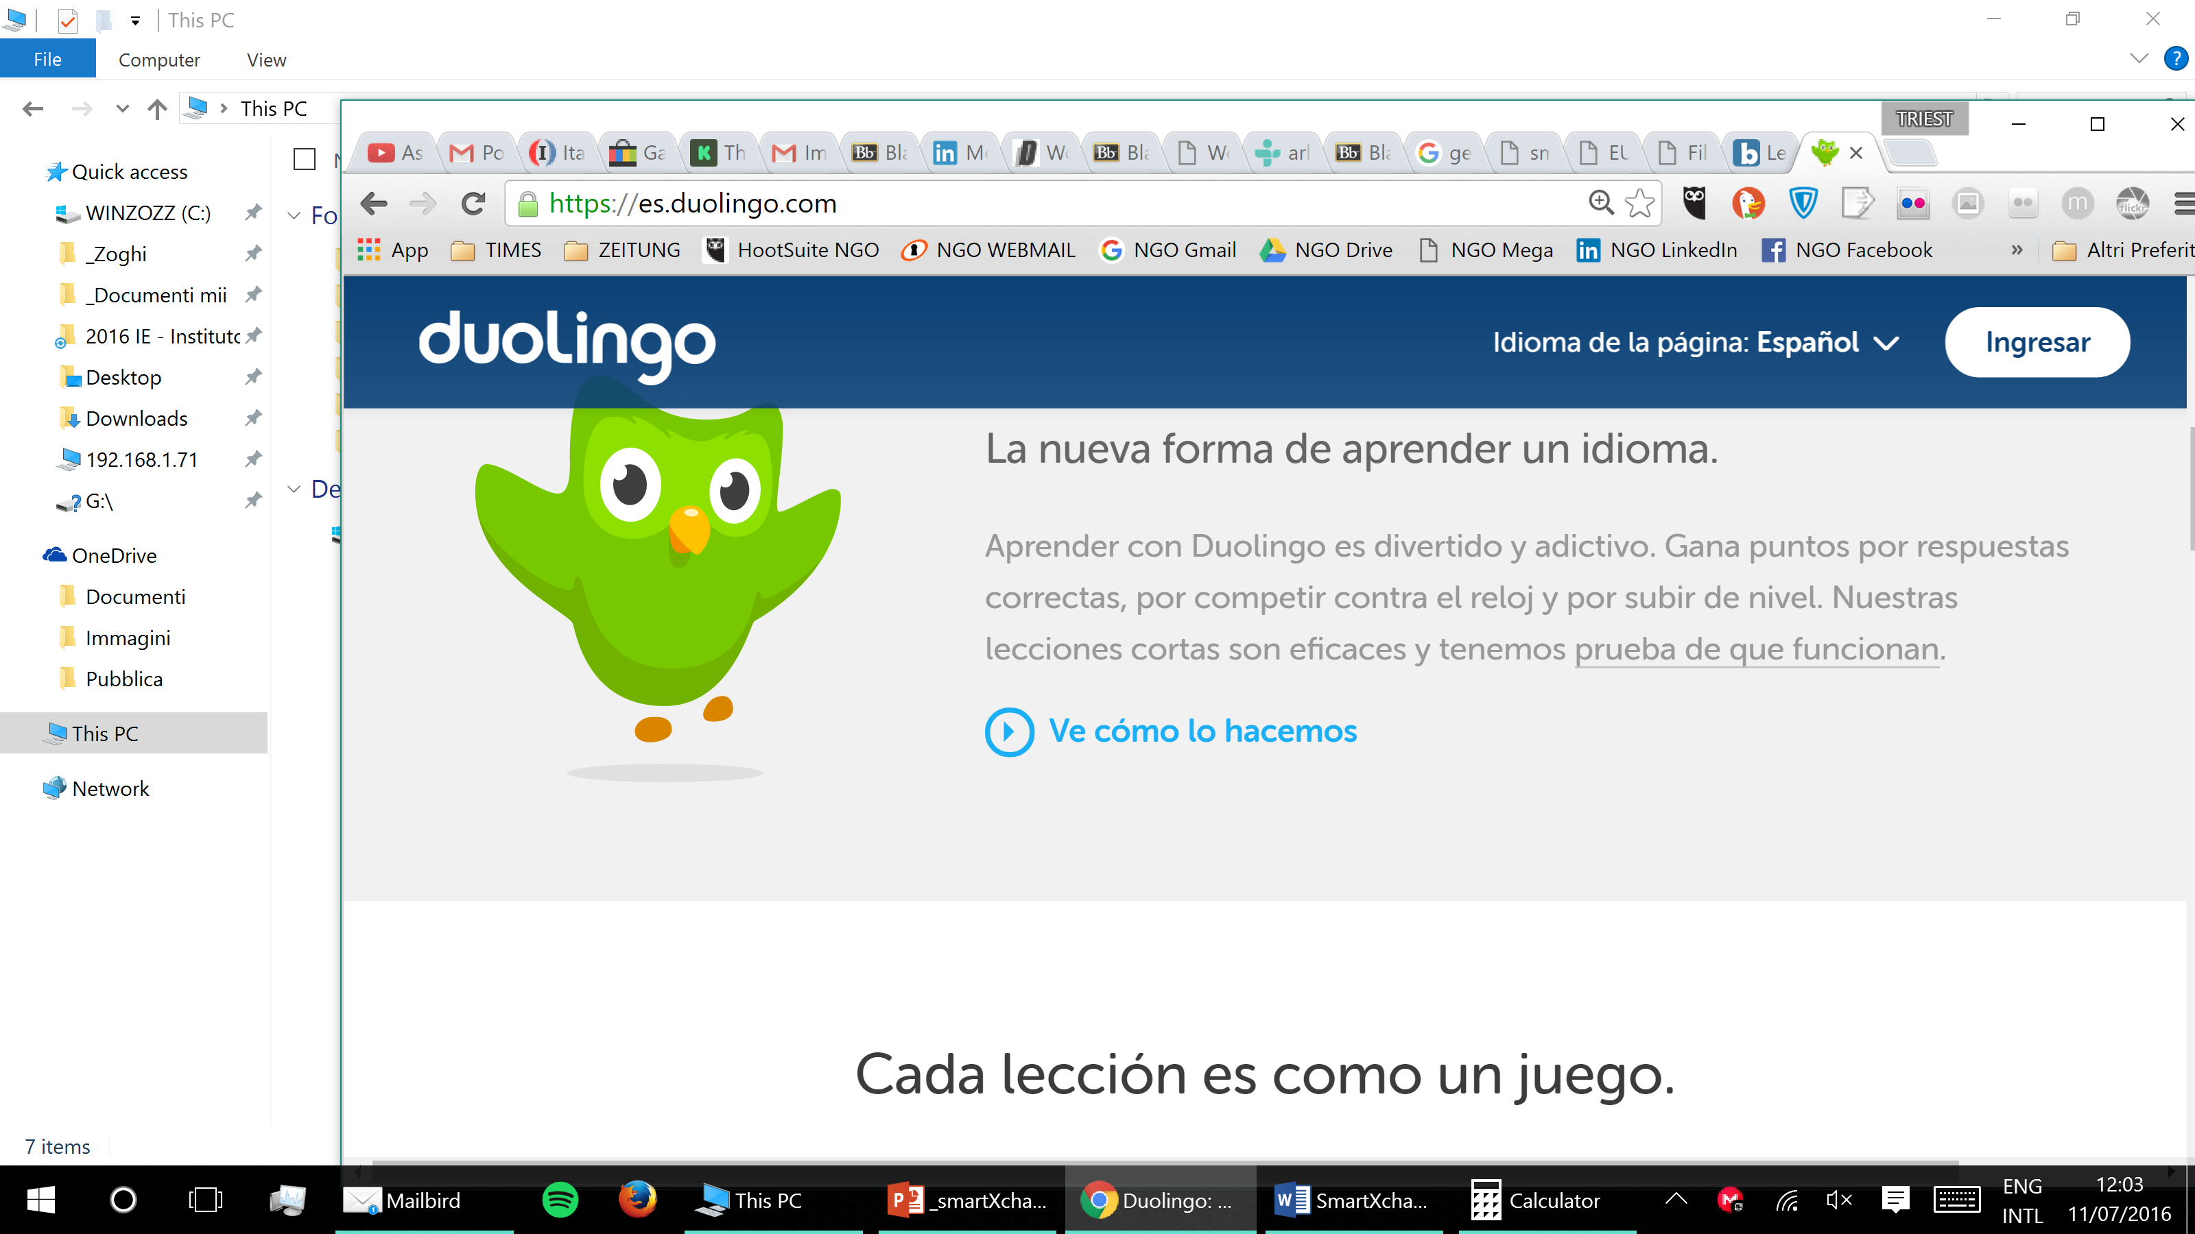
The best competitors
use cartoonish graphics and incorporate gamification.
THE ENVIRONMENT
Notes:
This made us think: how do we “exclusivity/seriousness”? WE WANT TO BE A PROFESSIONAL NETWORK

Slide 8
1.Madrid testing
ABOUT 30.000 EARLY ADOPTERS
2.EU expansion
MILLIONS OF FOREIGN RESIDENTS +
MANY MORE LOCALS IN TOP 5 COUNTRIES
THE ENVIRONMENT

Slide 9


Slide 10


Slide 11
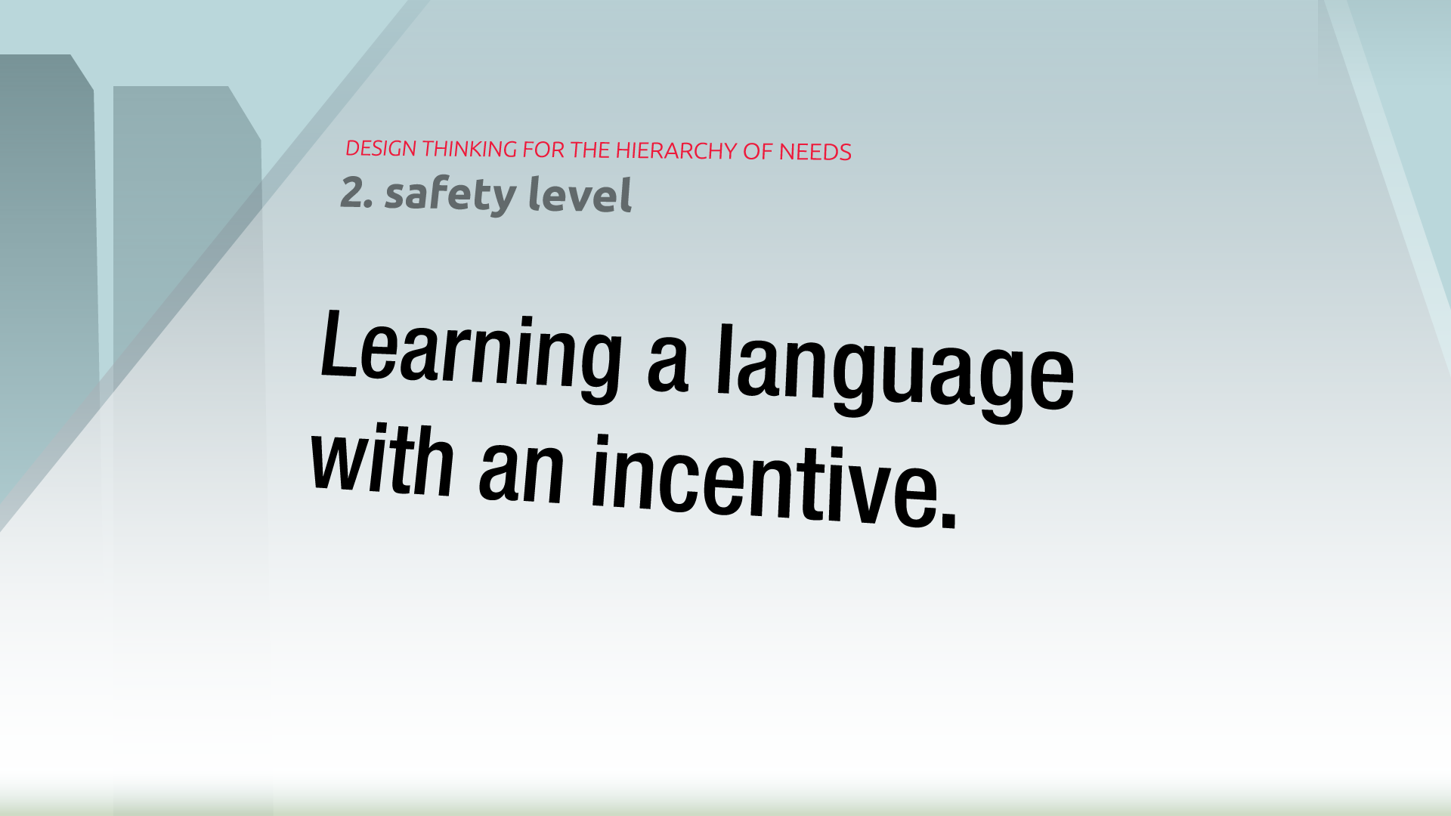

Slide 12


Slide 13
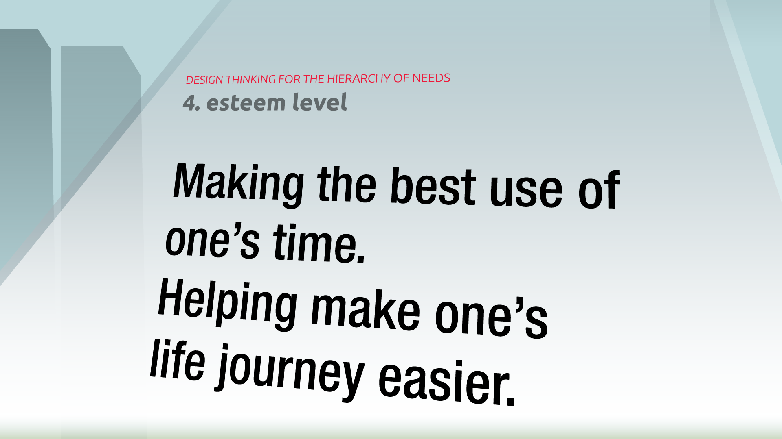

Slide 14


Slide 15
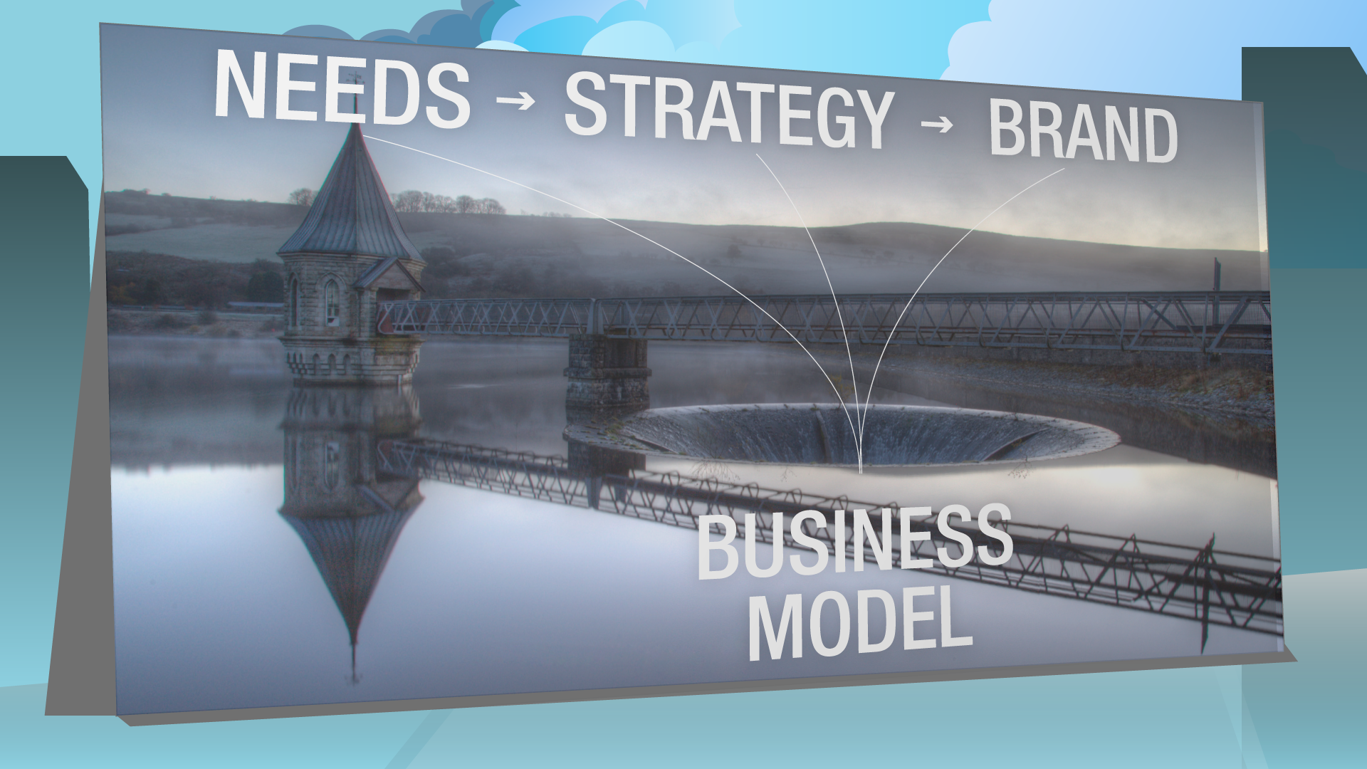
Notes:
Needs lead to a strategy, a strategy leads to a brand, and al these drive our tailored monetisation strategy. But more about that later.

Slide 16


Slide 17

PROTOTYPE LAUNCH
Notes:
Go to browser

Slide 18
CONCEPT INTERFACE

Slide 19
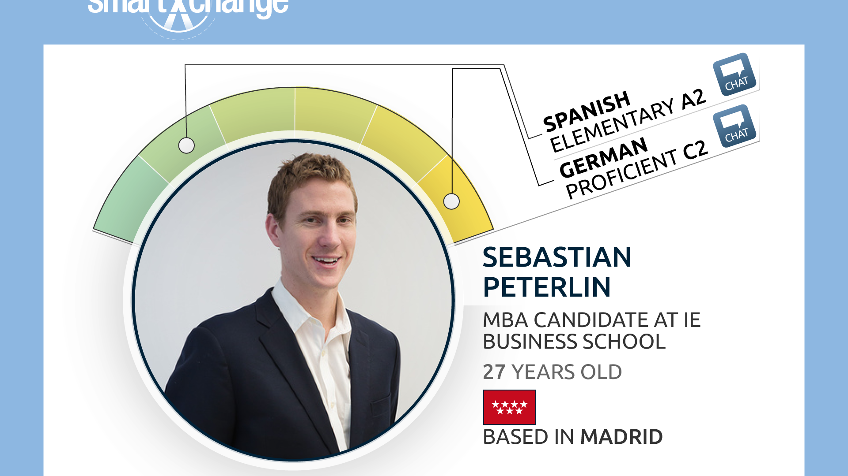
Notes:
Circles a bit bigger, flags inside

Slide 20
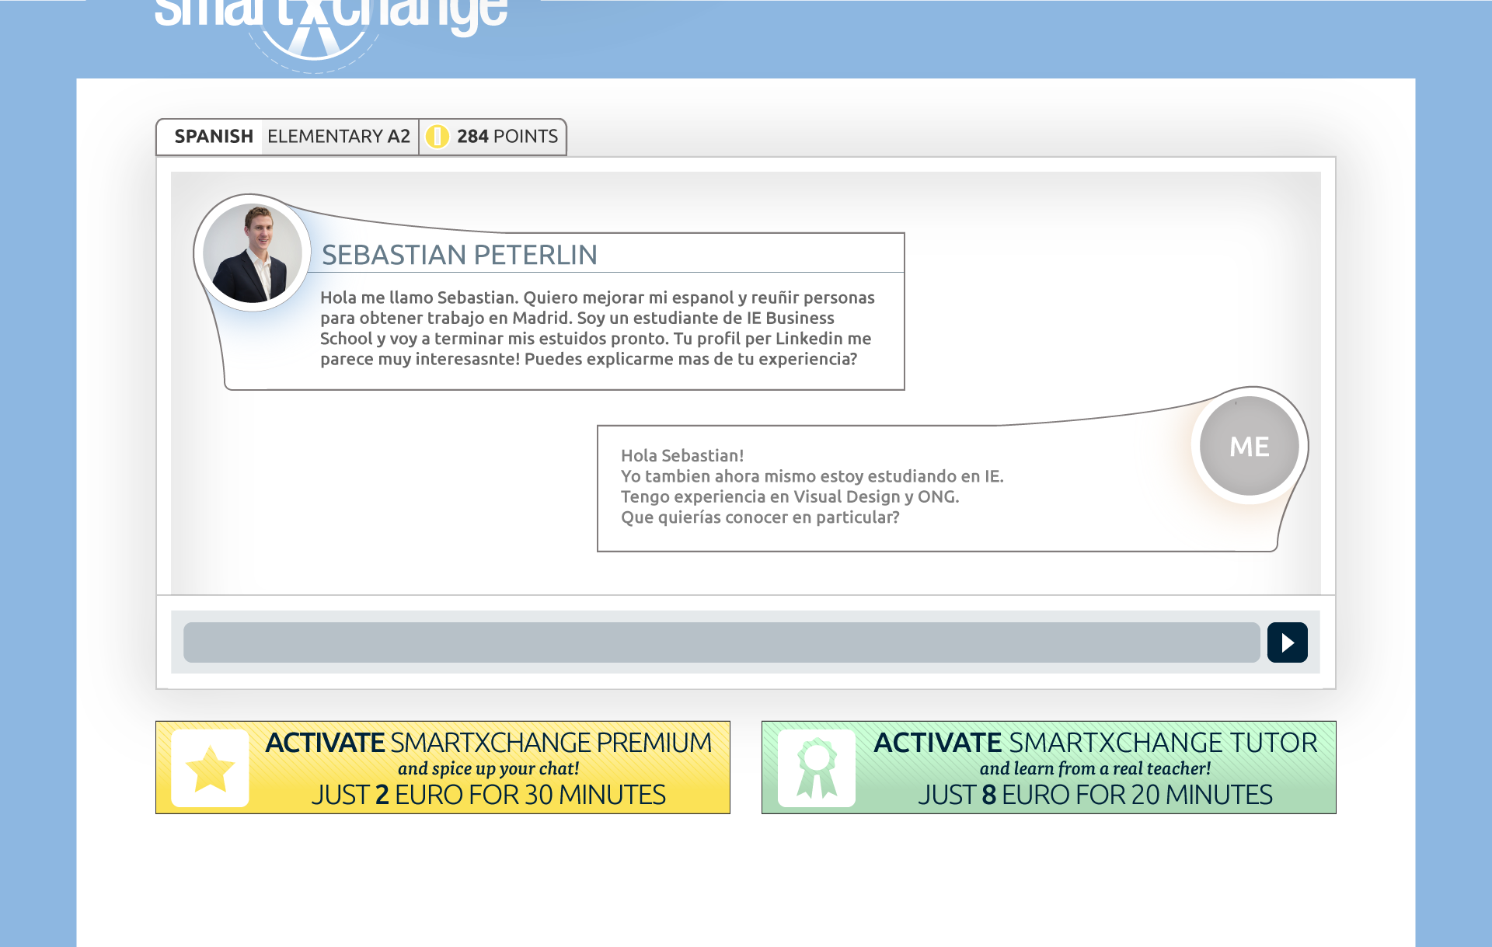

Slide 21
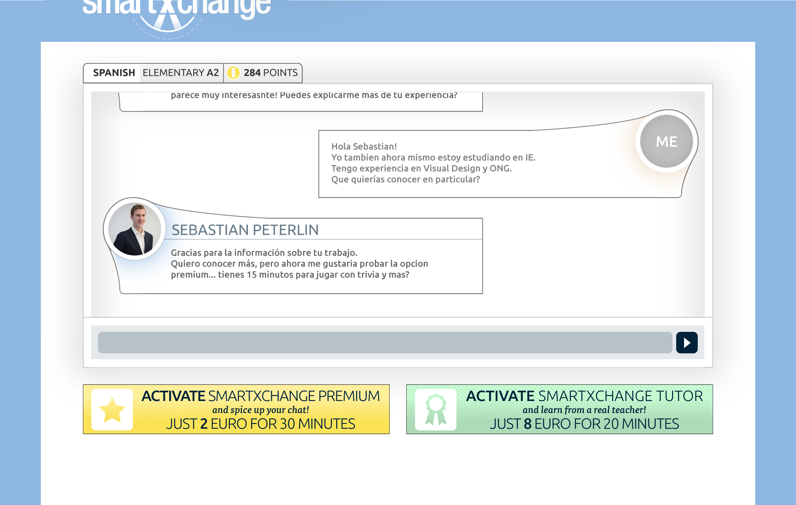

Slide 22
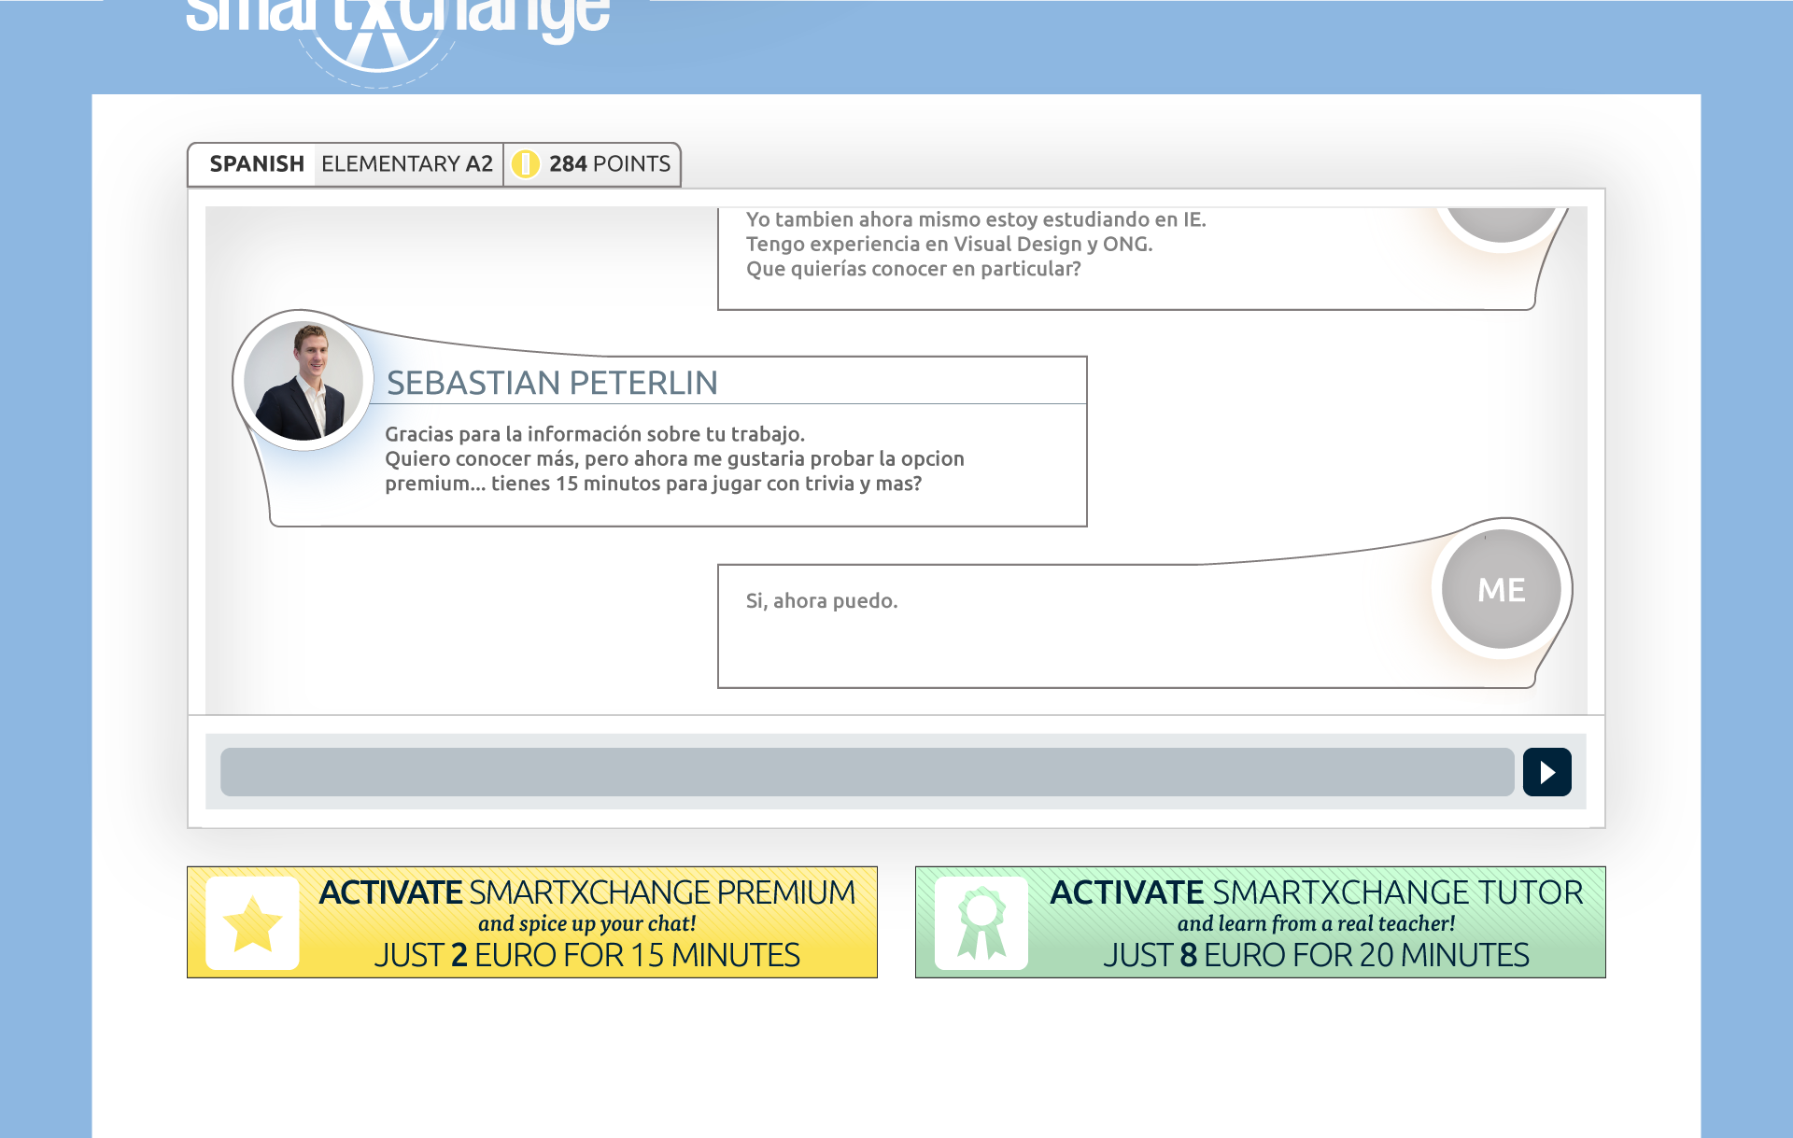

Slide 23
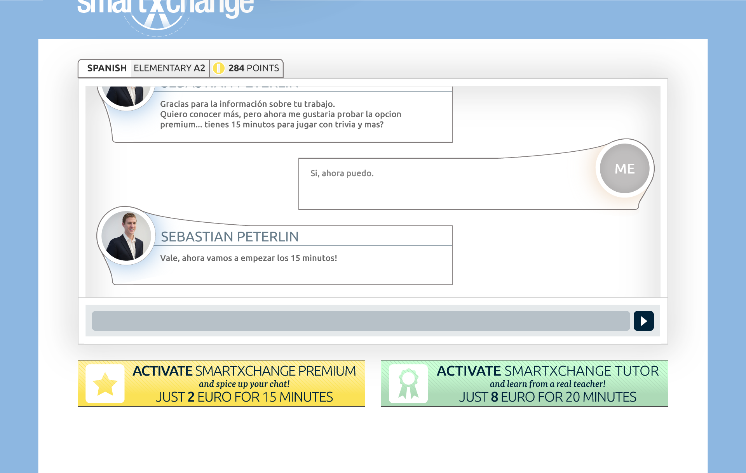

Slide 24


Slide 25
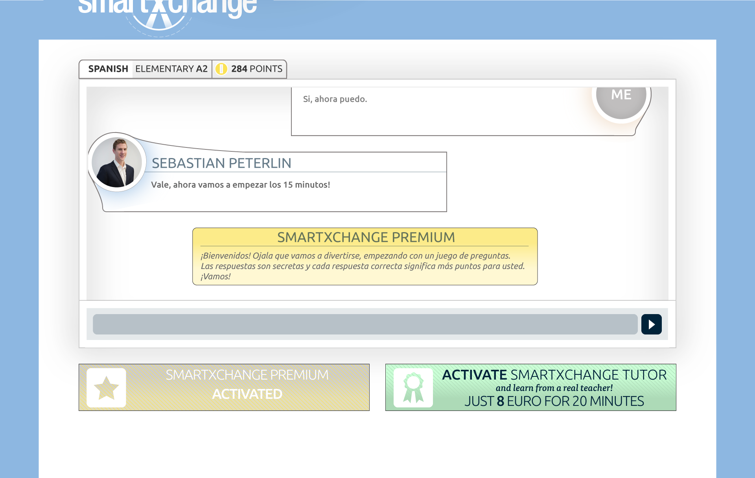

Slide 26
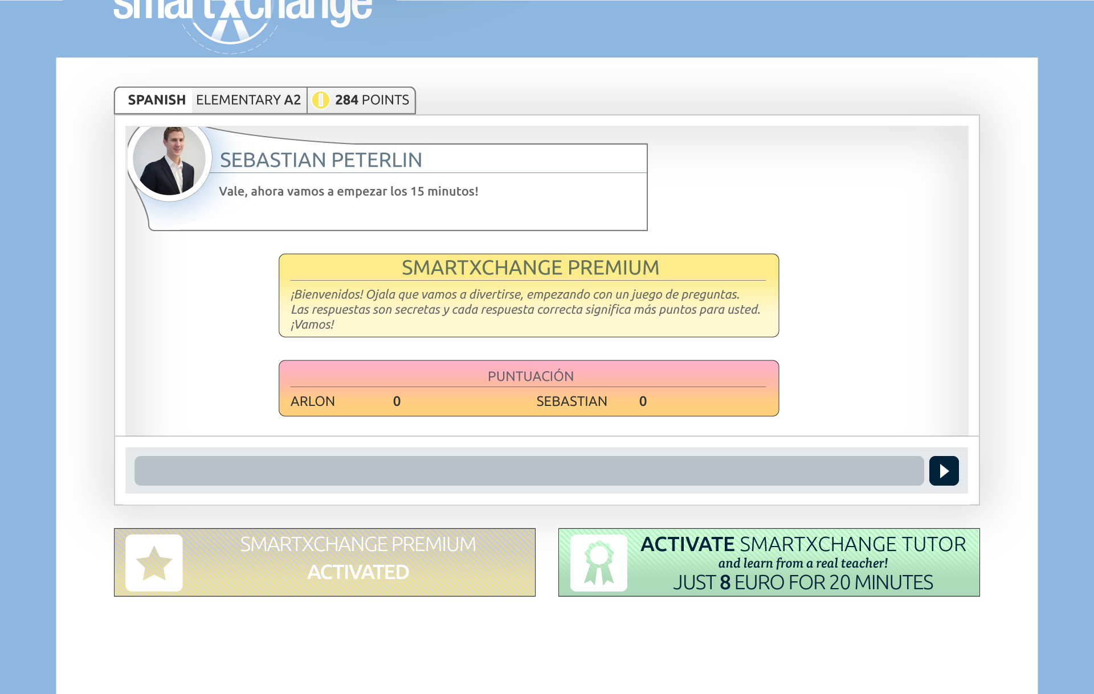

Slide 27
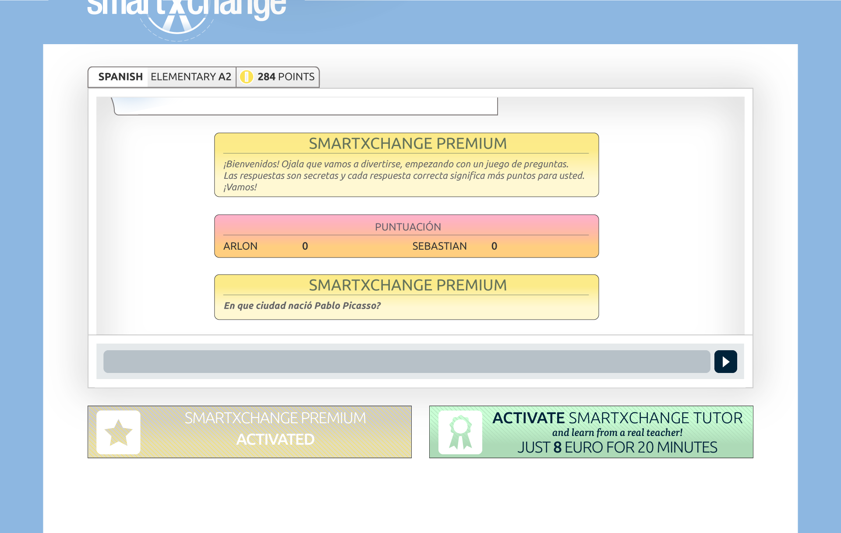

Slide 28
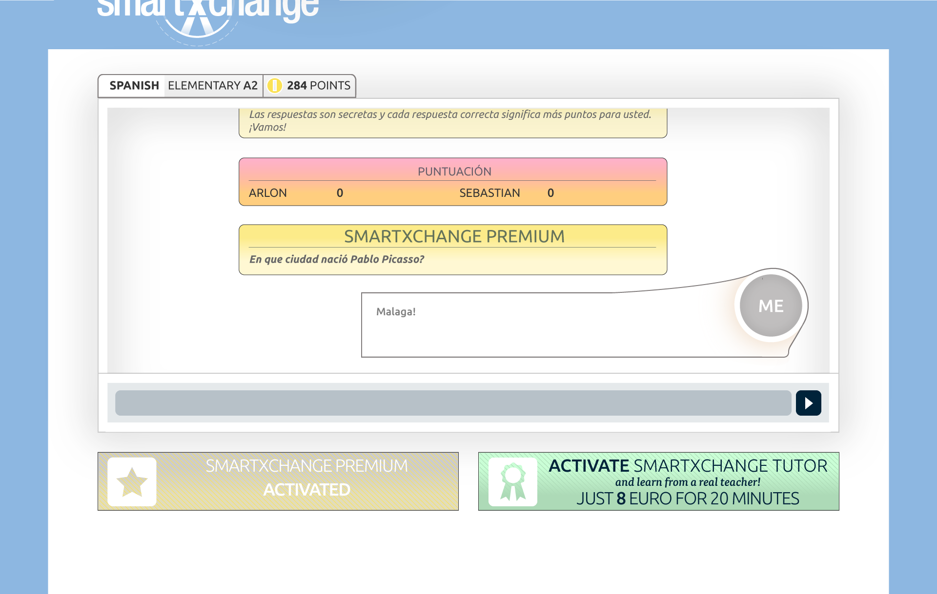

Slide 29
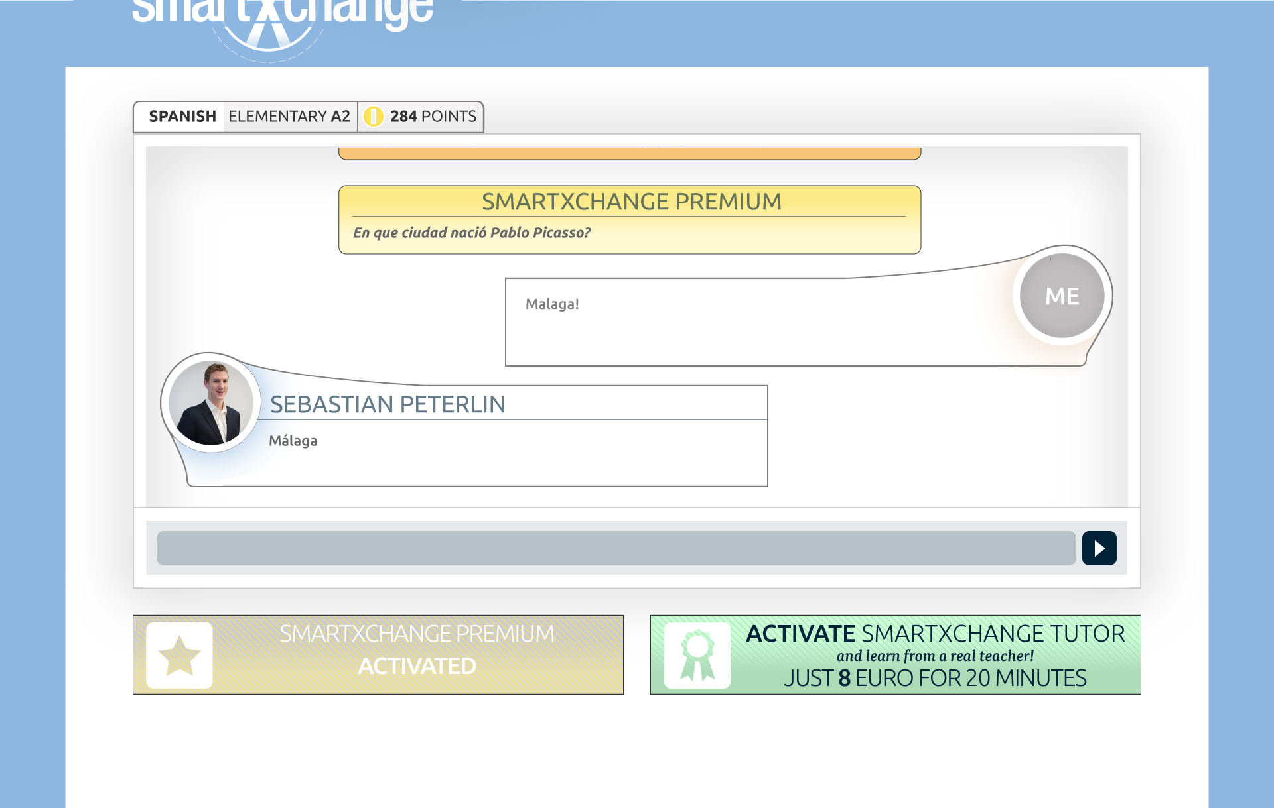

Slide 30
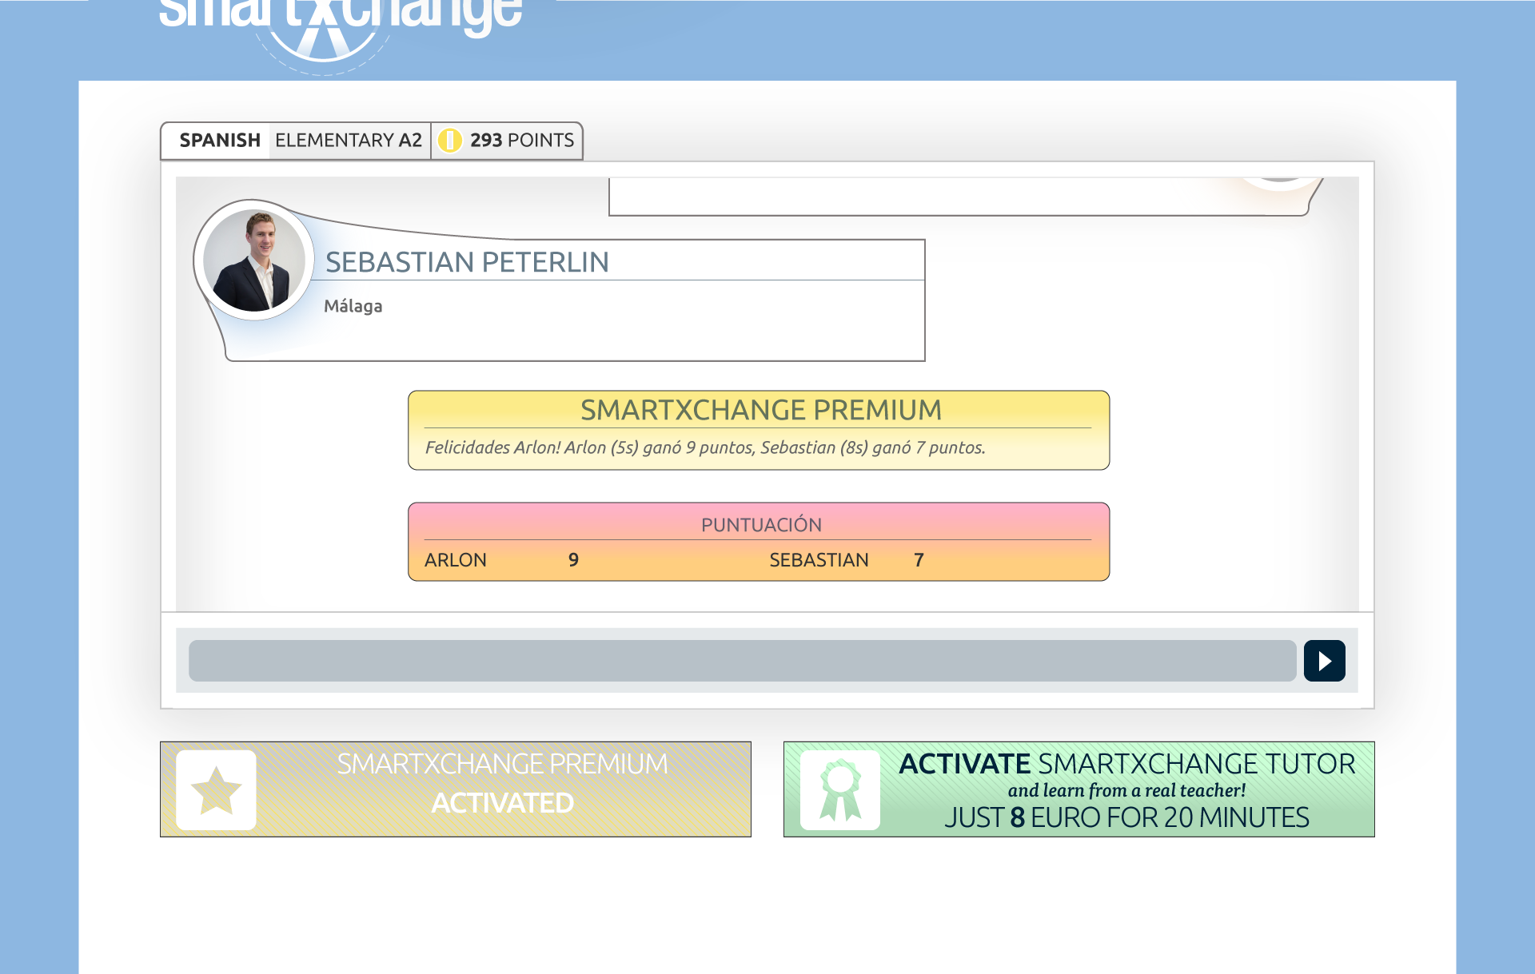

Slide 31
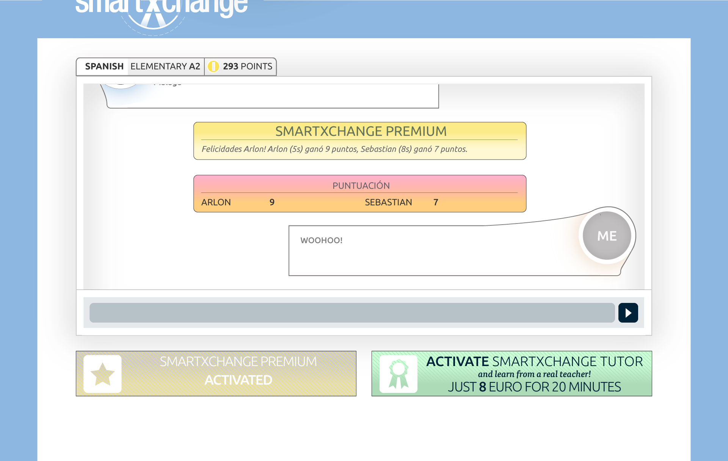

Slide 32
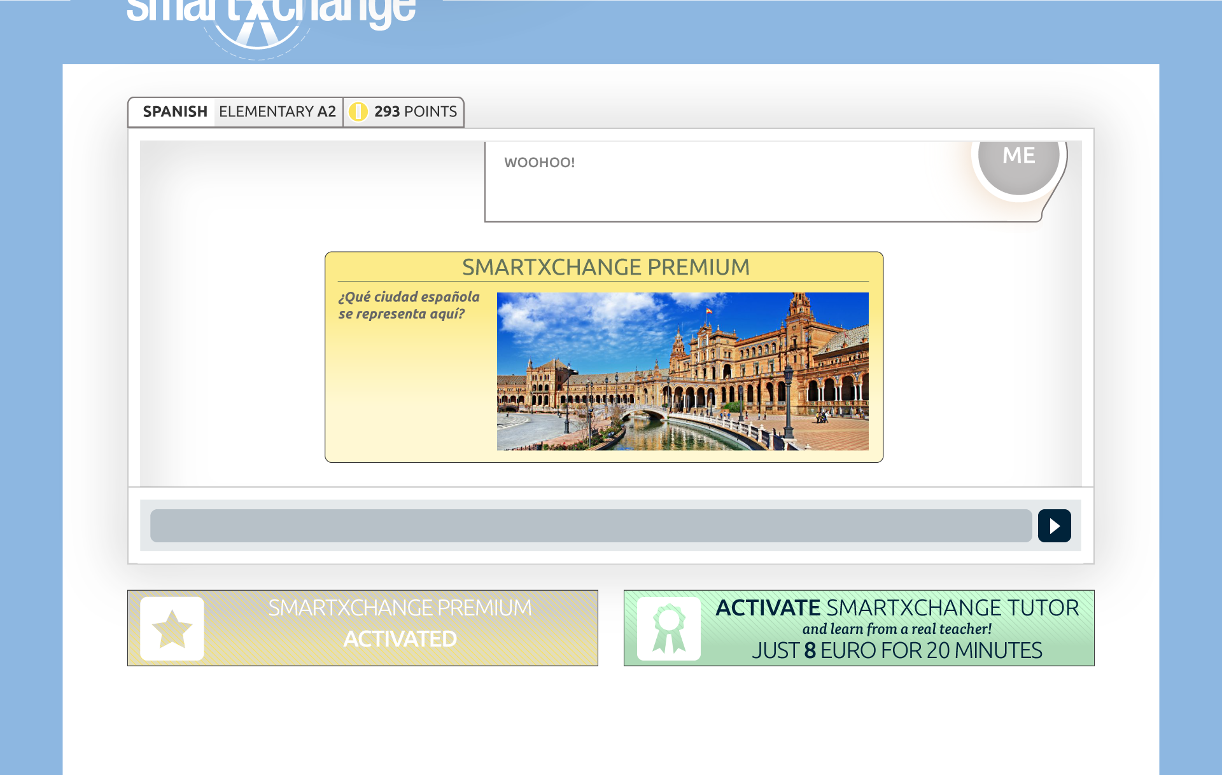

Slide 33

General service for B2C
Tailored service for B2B
www.smartxchange.es

